Slide 1

ACAD
SEARCH
CS 328 - Intro to Data Science
A crowd-sourced search engine to find leading professors

Slide 2

MOTIVATION
Students often need to search for professors.
Google Scholar provides less control over search results.
A tool focused towards students searching for professors.

Slide 3

OBJECTIVES
Search Engine for professors based on name, topic, paper title, etc.
Ranking and filtering based on h-index, citations over last 5 years, conferences, etc.
Ranking metric based on the data.

Slide 4

HIGH LEVEL
ARCHITECTURE

Slide 5
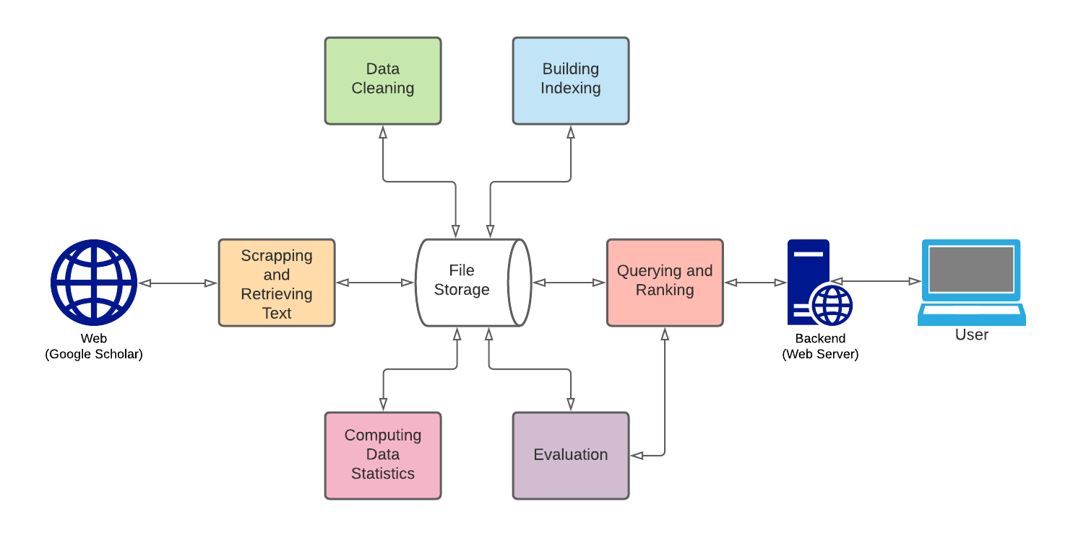

Slide 6

DATA COLLECTION

Slide 7
SOURCE
List of Google Scholar IDs from CSRankings GitHub Repository
20K
16.5K
13.2K
Repo
Scraped
Cleaned

Slide 8
SCRAPING
Data scraped per professor:
• Name
• Affiliation
• Profile Image URL
• Verified Email at
• Homepage URL
• Research Topics List
• Citation (overall & 5 yrs)
• H-Index (overall & 5 yrs)
• I-Index (overall & 5 yrs)
• Citation List Year-wise
• Titles: Top 100 Cited Papers
• URLs: Top 100 Cited Papers

Slide 9

AVOIDING GETTING BLOCKED
Pass request headers to appear as a browser.
Random delays of 1-3 seconds between requests.
Divide across multiple IP addresses.

Slide 10

PRE
PROCESSING

Slide 11
CLEANING
TEXT PRE-PROCESSING
Removed redundant entries.
Some Google Scholar pages did not follow the same HTML conventions as the rest. Cleaned such corruptions using regular expressions.
Convert to lower-case.
Perform stemming.
Remove stop words.

Slide 12

DATA STATISTICS

Slide 13
BASICS
Number of professors | 13285
Number of institutions | 8716
Number of publications | 893575
Average number of publications per professor | 79.80
Size of data after cleaning | 232 MB

Slide 14
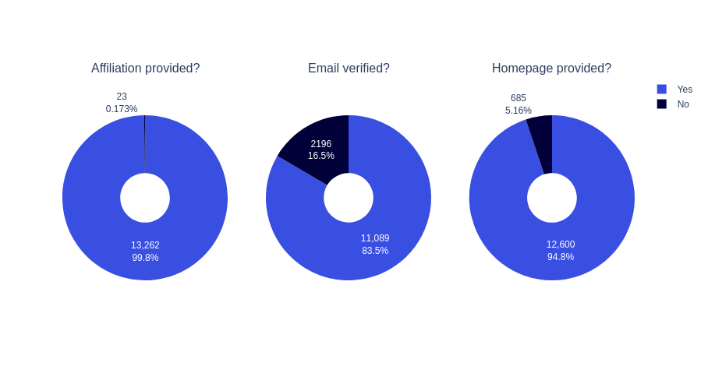

Slide 15
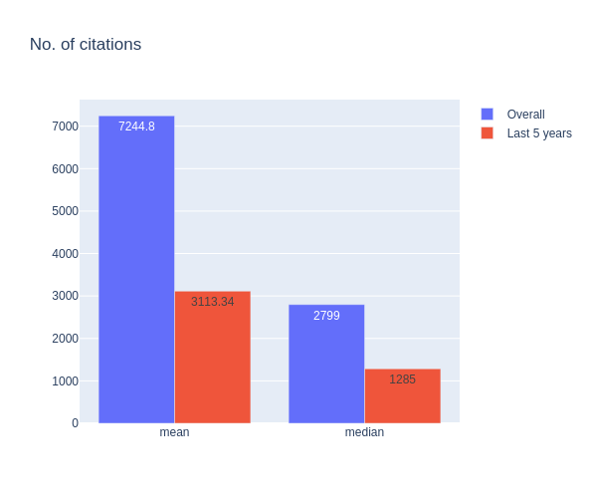

Slide 16
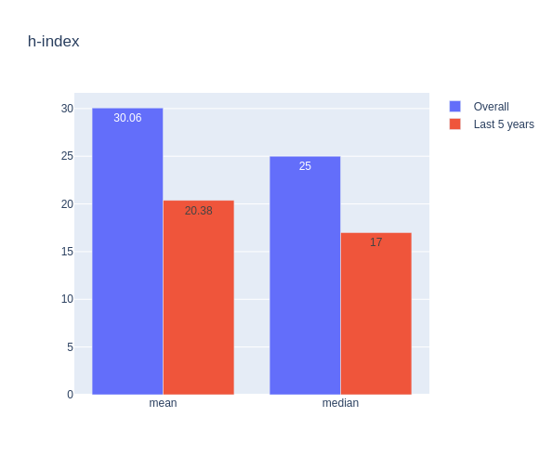

Slide 17
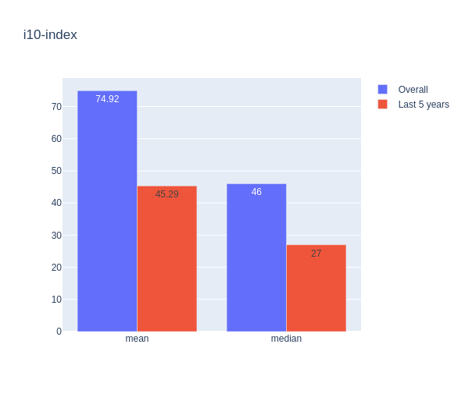

Slide 18
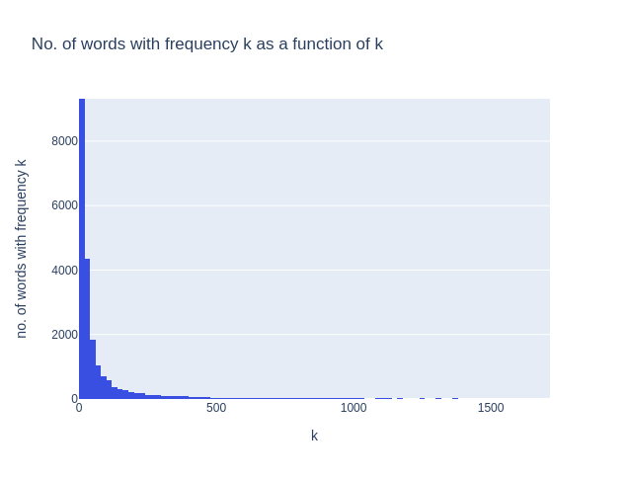

Slide 19

INDEXING

Slide 20
2 INDICES
INVERTED INDEX
Research topics and paper titles
Name and Affiliation(Institution)
{
‘machin’ : [ [0, 12], [3, 16],
[6, 9] ],
‘learn’ : [ [0, 13], [3, 17],
[8, 18] ]
}

Slide 21

QUERYING & RANKING

Slide 22
BOOLEAN RETRIEVAL
PHRASE RETRIEVAL
AND: Return professors that contain all the words from the query
OR: Return professors that contain at least 1 word from the query.
Optimisation
Allows users to search for exact matches for phrases.
The word positions stored in the inverted index is used.

Slide 23
TF-IDF
(Term Frequency-Inverse Document Frequency)
TF-IDF(t, d, D) = TF(t, d) x IDF (t, D)
TF: measure of how frequently a word/term appears in a document, normalised by the document size.
TF(t, d) = no. of times t appears in d ÷ total no. of words in d
IDF: measure of how much information a word provides, i.e., if it's common or rare across all documents.
IDF(t, D) = log[no. of documents ÷ (1 + no. of documents containing t)]

Slide 24
SORTING RESULTS
Users can sort search results based on no. of citations, h-index, no. of citations in last 5 years etc.
Boolean and phrase retrieval results are sorted using a default ranking metric.
DEFAULT RANKING METRIC
Linear combination of h-index, i10-index, no. of citations, h-index(last 5 yrs), i10-index(last 5 yrs), citations(last 5 yrs)

Slide 25

WEB SERVER
Built using Flask.
An interface for users to use the search engine.
Hosted here.

Slide 26
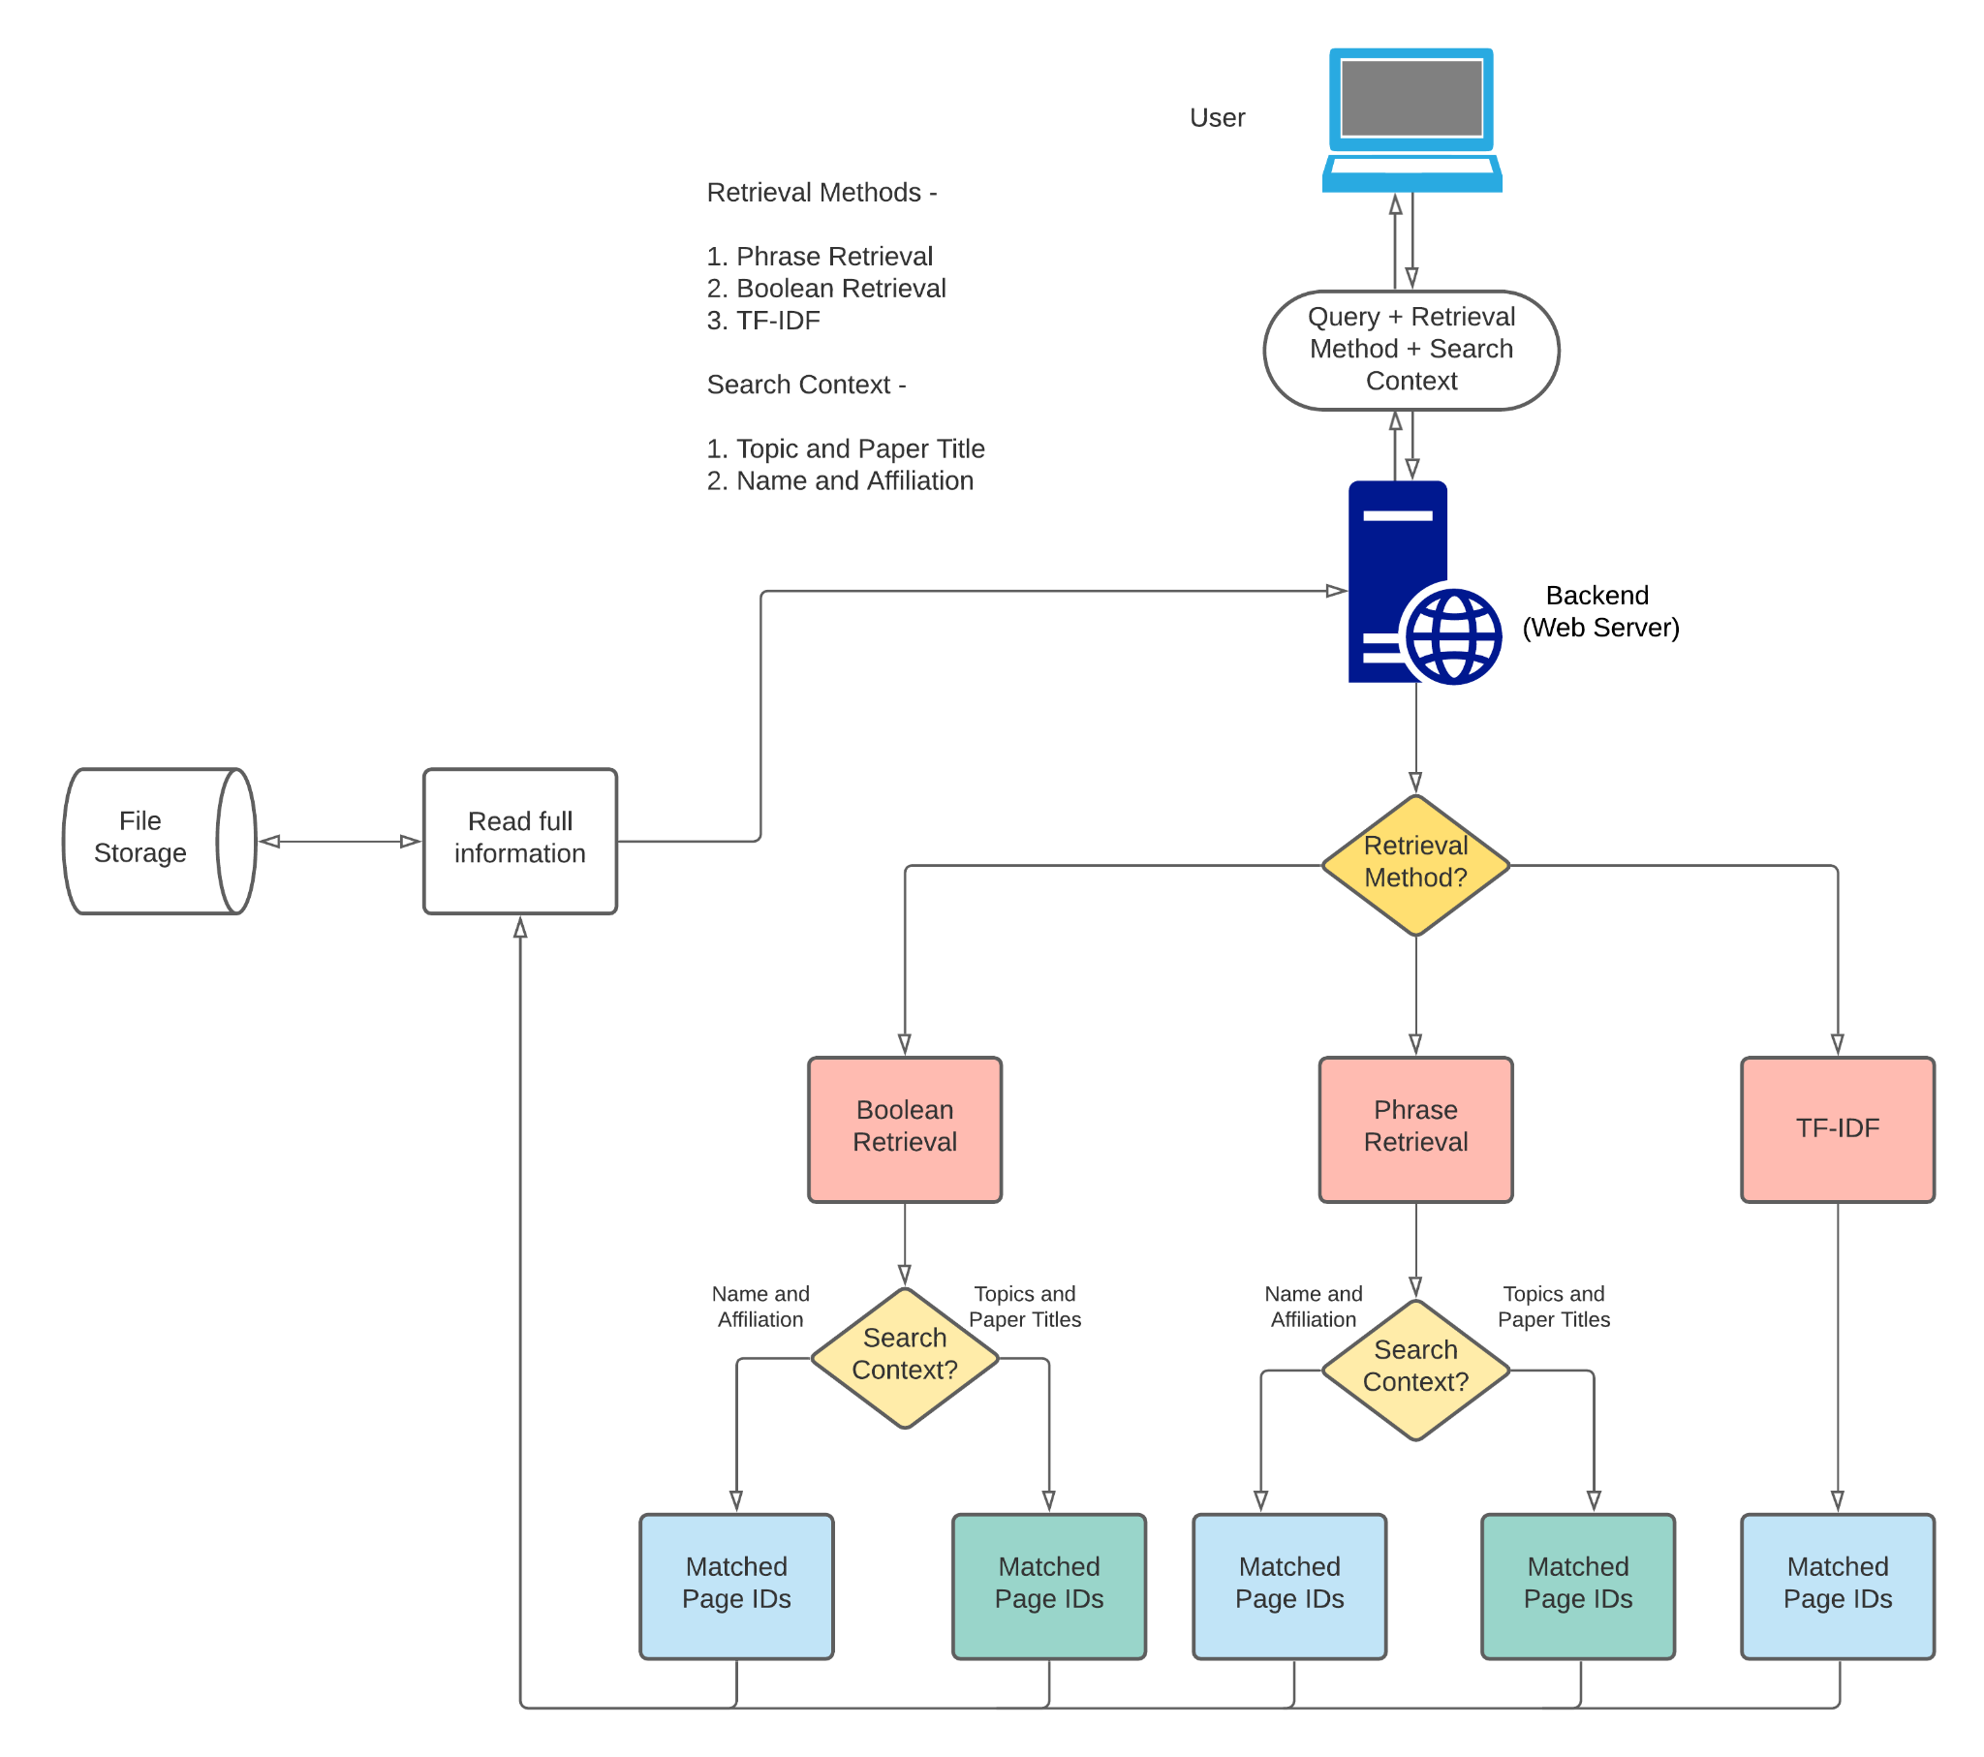

Slide 27

EVALUATION

Slide 28
MEDIAN RANK
Median of the ranks achieved by the ground truth in the search results, over a large number of searches.
RECALL RATE, R@X
Percentage of times that the ground truth appears in the top X results.
AVERAGE TIME PER QUERY
Time taken by retrieval algorithms to return matched document IDs.

Slide 29
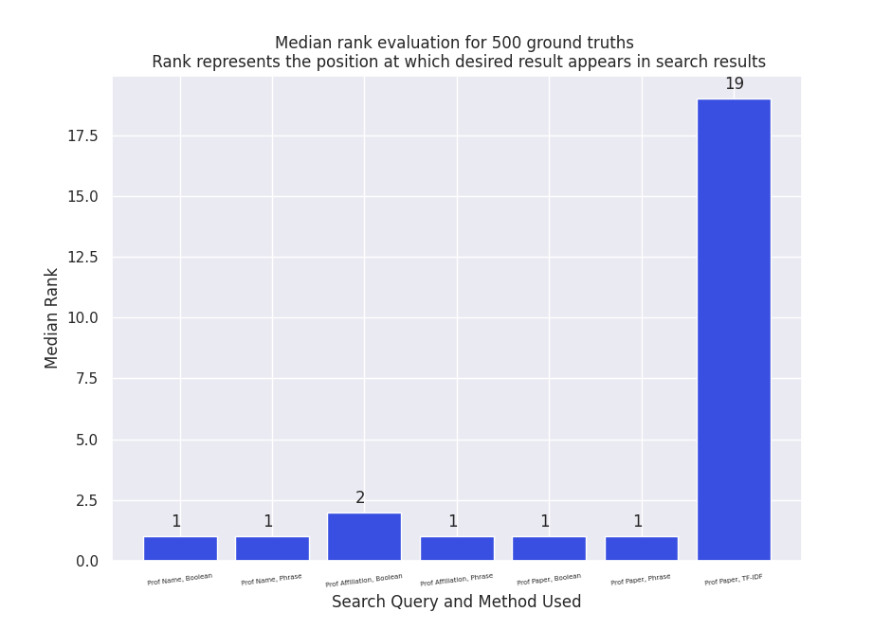

Slide 30
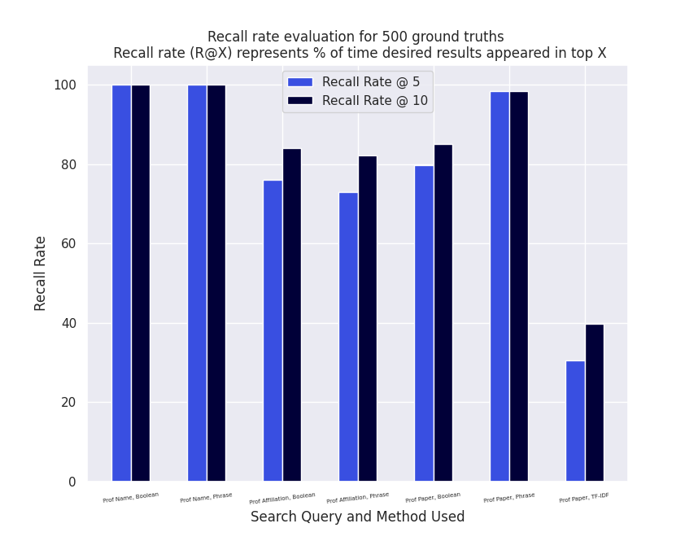

Slide 31
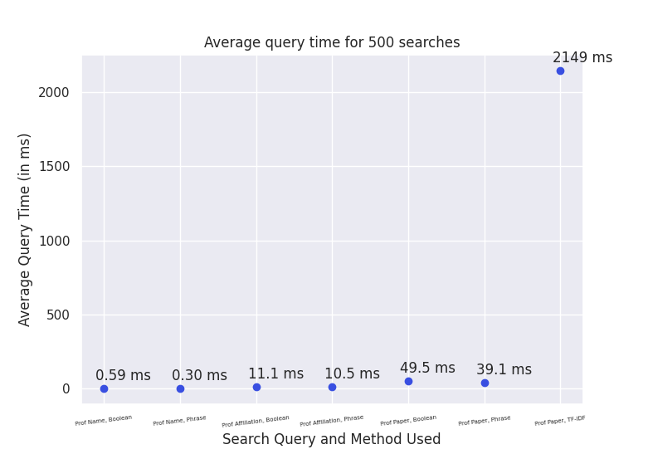

Slide 32

DEMO

Slide 33

FUTURE
WORK

Slide 34
FUTURE WORK
Scraping more data
Improving user experience
Personalizing search results
Performing user tests
Using page ranking on citation data
Learning the default ranking metric from user feedback

Slide 35
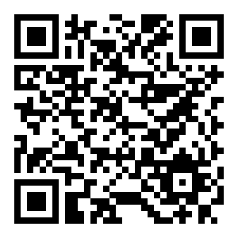
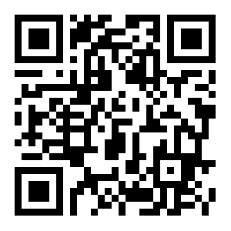
GitHub Repository: link
Web App: link
GROUP MEMBERS
Amey Kulkarni (18110016)
Chris Francis (18110041)
Nishikant Parmar (18110108)
Repo
ACKNOWLEDGEMENTS
Special thanks to Prof. Anirban Dasgupta for his valuable guidance and feedback.
Web App

